Slide 1
RESEARCH agent
IBM CAPSTONE PROJECT
Presented By:
Subrahmanyam Panchakarla
KBN College, Vijayawada
Computer science Department

Slide 2
OUTLINE
Problem Statement
Technology used
Wow factor
End users
Result
Conclusion
Git-hub Link
Future scope
IBM Certifications

Slide 3
Problem Statement
Students, researchers, and professionals struggle with the overwhelming volume of academic papers and fragmented research tools. Manual literature reviews, citation formatting, and identifying research trends are time-consuming and inefficient.
Proposed Solution: An AI Research Agent built using Watsonx, IBM Granite, and NLP, capable of:
Searching and summarizing academic content
Generating citations
Recommending related papers
Suggesting hypotheses and drafting sections

Slide 4
Technology used
IBM cloud lite services
Watsonx Assistant (No-Code)
Watsonx Prompt Lab
IBM Granite Foundation model

Slide 5
IBM cloud services used
IBM Cloud Watsonx AI Studio
IBM Cloud Watsonx AI runtime
IBM Cloud Agent Lab
IBM Granite foundation model
Watsonx Assistant
IBM Cloud Object Storage

Slide 6
Wow factors
🔍 Semantic search over academic domains
📝 Auto-summarization of research papers
🔗 Citation generation in APA/MLA/IEEE
📈 Trend analysis over time
🤝 Collaboration mapping for co-author suggestions
🧪 Hypothesis suggestion + research section drafts

Slide 7
End users
Academic Researchers
Research Institutions and Universities
Industry R&D Teams
Educators
Scientific Publishing Platforms

Slide 8
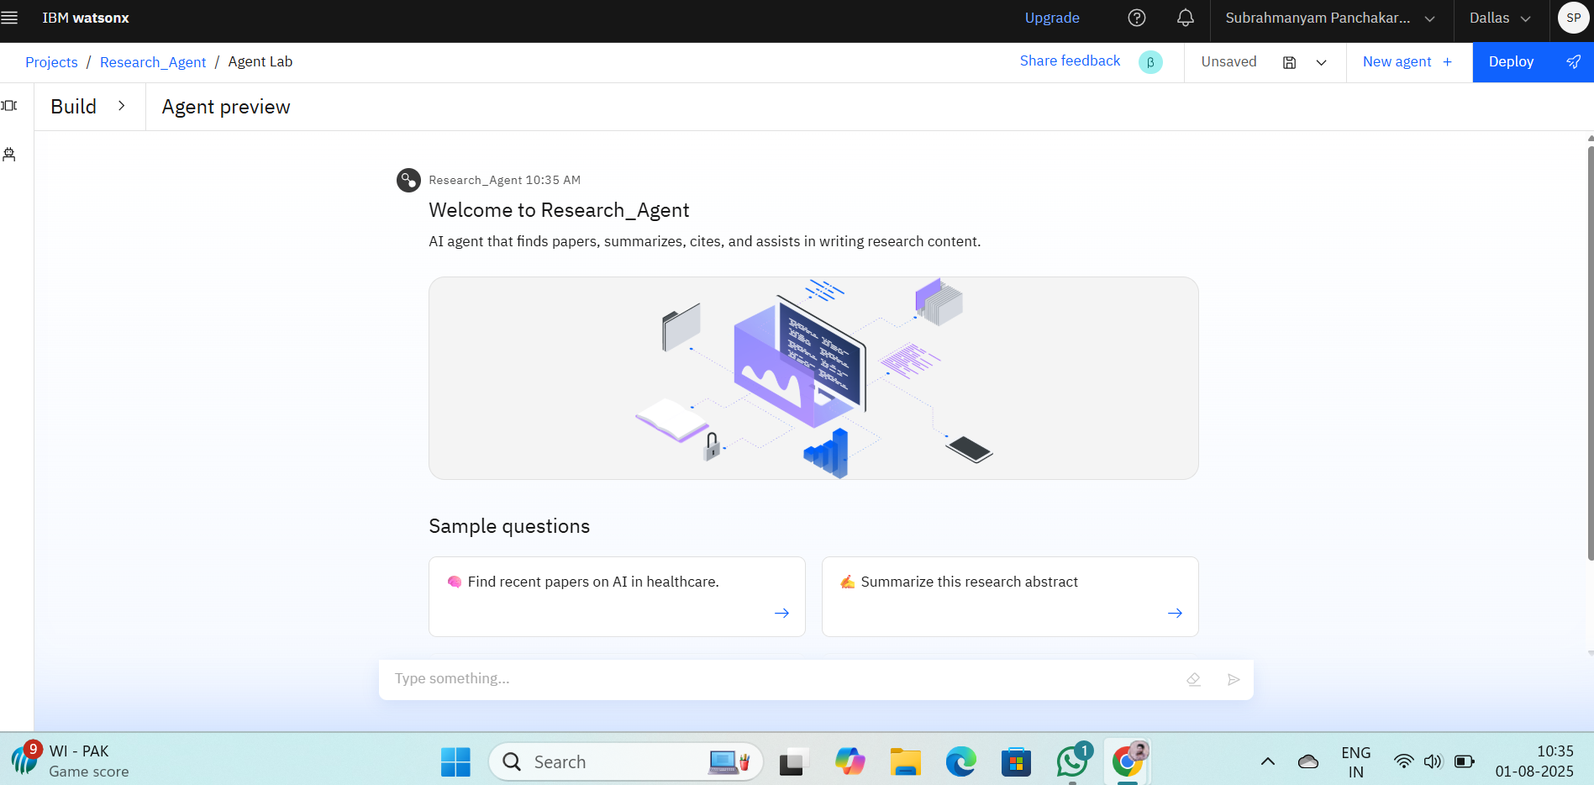
Results
Functional, prompt-driven AI agent live on Watsonx
Assistant
Tested with research queries across various domains
Demonstrated reduced time in literature review & writing
Supports APA/MLA formatting for citations

Slide 9
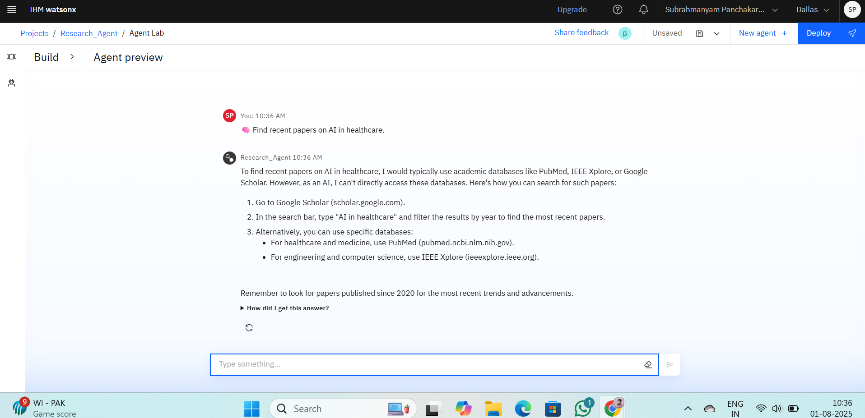
Results

Slide 10
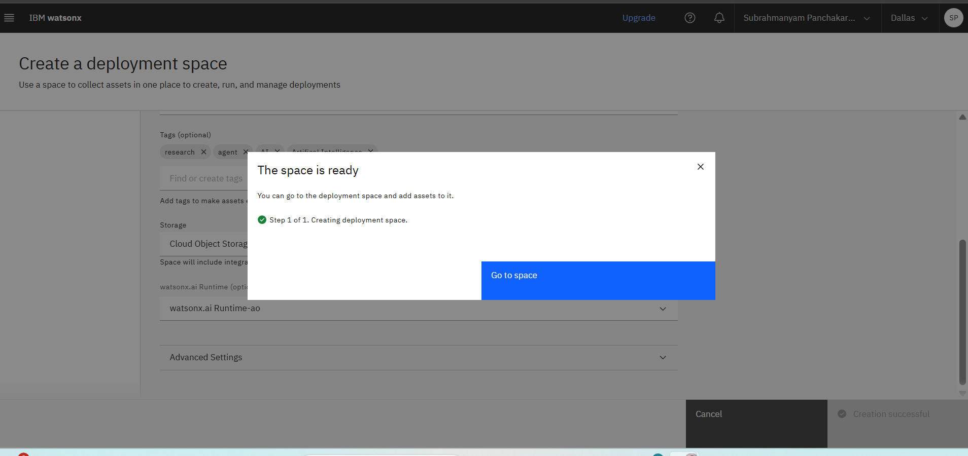
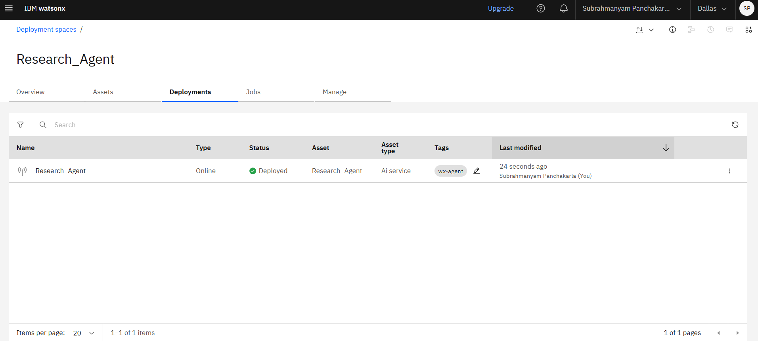
Results
Deployed AI Agent

Slide 11
Conclusion
The agent can generate reports, suggest hypotheses, and even draft sections of research papers.
It saves time by automating repetitive tasks like citation management and data extraction.
Research Agents enhance efficiency, accuracy, and innovation in both academic and industrial R&D.

Slide 12
GitHub Link
https://github.com/SubbuPachakarla/AICTE_IBM-Internship-project

Slide 13
Future scope
Multilingual Research Support
Voice-Activated Research Assistant
Real-Time Collaboration Features
Research Gap and Novel Topic Identification
Integration with Publishing Platforms
AI-Assisted Paper Drafting

Slide 14
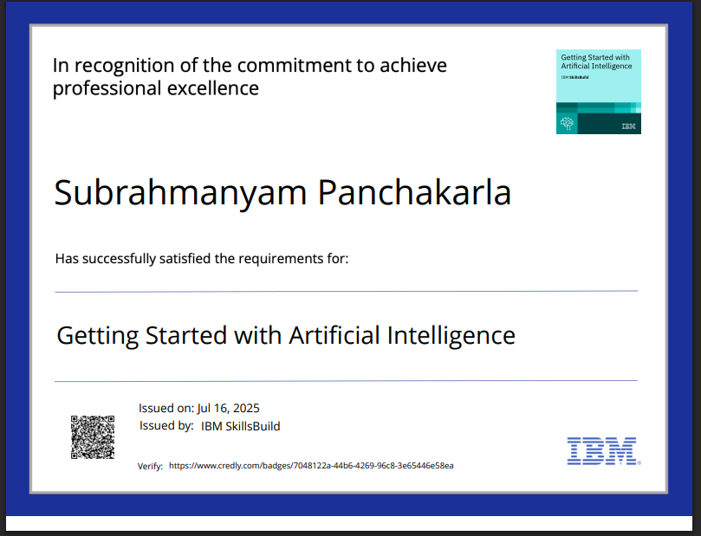
IBM Certifications

Slide 15
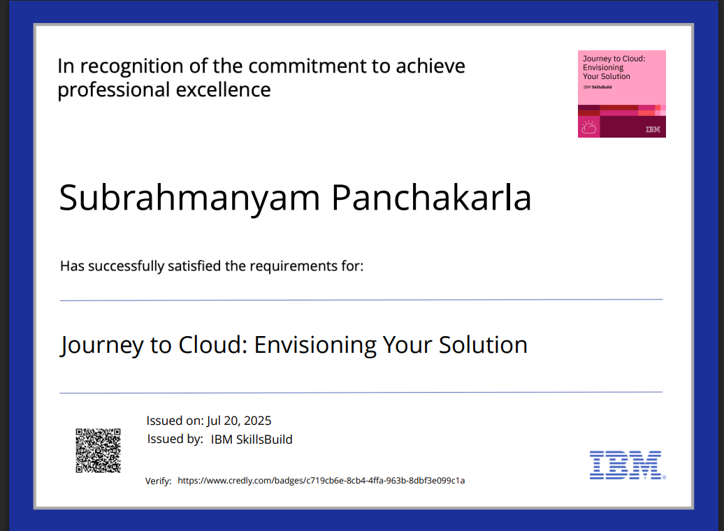

Slide 16
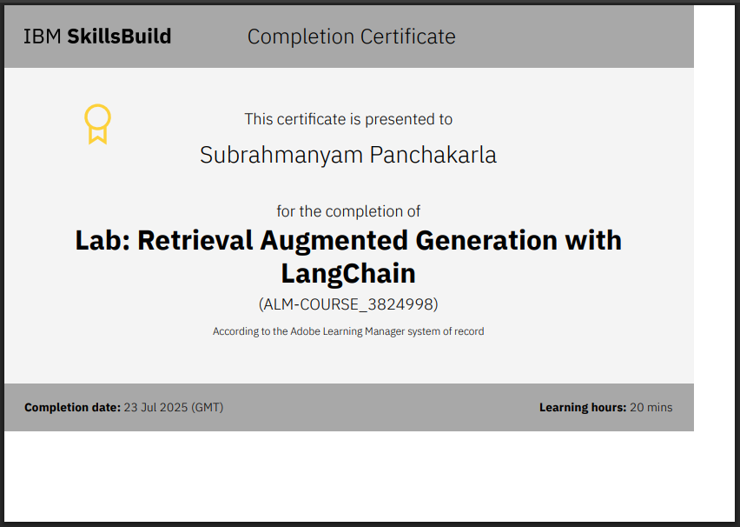

Slide 17
THANK YOU

